Slide 1

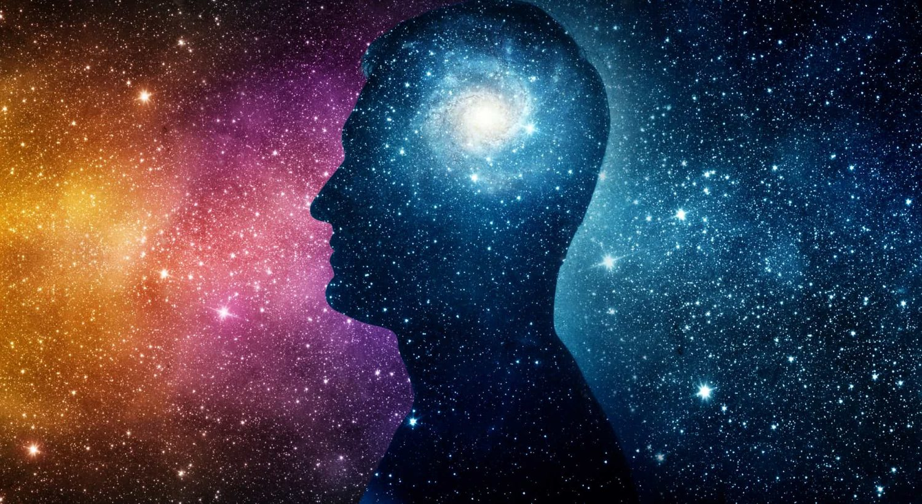
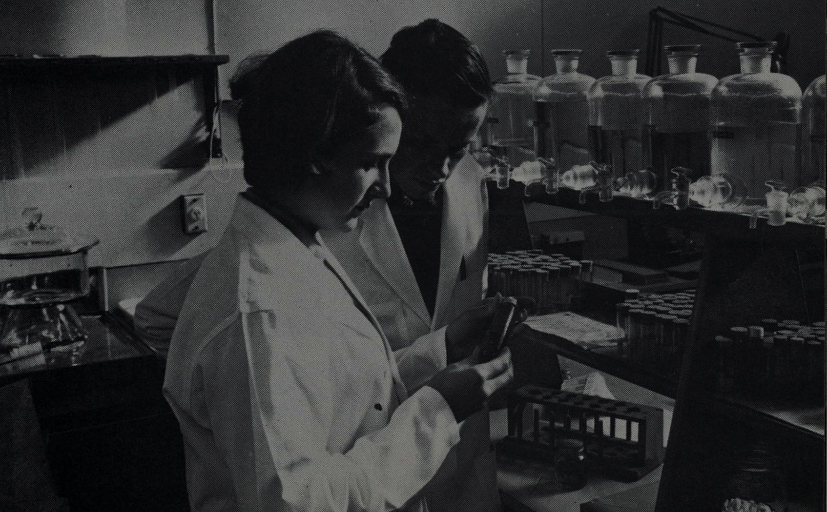


Experience of Reality
Conscious and Unconscious Feelings and Beliefs about Reality
PrimalsInteroception
IllusionGame
FictionEro
Pyllusion
FakeNews
Metascience
Tools
Improving science
Developping tools
Context
History
Philosophy of science
Avengers
Neuropsychological Profile
Who are we?
Sense of Self
Core Personality
…
How to measure it?
Psychometry
Clinical applications
…
NeuroKit
Body
Affective reactions, Bodily Signals,
Interoception, Embodiment
Mind
Cognitive Control, Executive functions, Suggestibility
Interoception Assessment
Emotion Regulation Task
DoggoNogo
Methods
Computational modelling
Bayesian inference
Signal processing
Neuroimaging
Chaos theory
…
Physiological Control
Phenomenological Control
Cognitive Control
Willpower
(In)voluntary control of oneself
Notes:
Computational neuropsychology

Slide 2
Experience of Reality
Conscious and Unconscious Feelings and Beliefs about Reality
Metascience
Tools
Improving science
Developping tools
Context
History
Philosophy of science
Neuropsychological Profile
Who are we?
Sense of Self
Core Personality
How to measure it?
Psychometry
Clinical applications
Body
Affective reactions, Bodily Signals,
Interoception, Embodiment
Mind
Cognitive Control, Executive functions, Suggestibility
Methods
Computational modelling
Bayesian inference
Signal processing
Neuroimaging
Chaos theory
…
Physiological Control
Phenomenological Control
Cognitive Control
Willpower
(In)voluntary control of oneself
Notes:
Computational neuropsychology

Slide 3

















Reality Bending
Core Self
Metascience
What are the mechanisms that drive and can alter our belief and feeling of reality?
How do cognitive abilities unfold into personality traits and metastable neuropsychological profiles?
What is the history of psychology and psychiatry? What are the methods and tools of tomorrow?

Slide 4



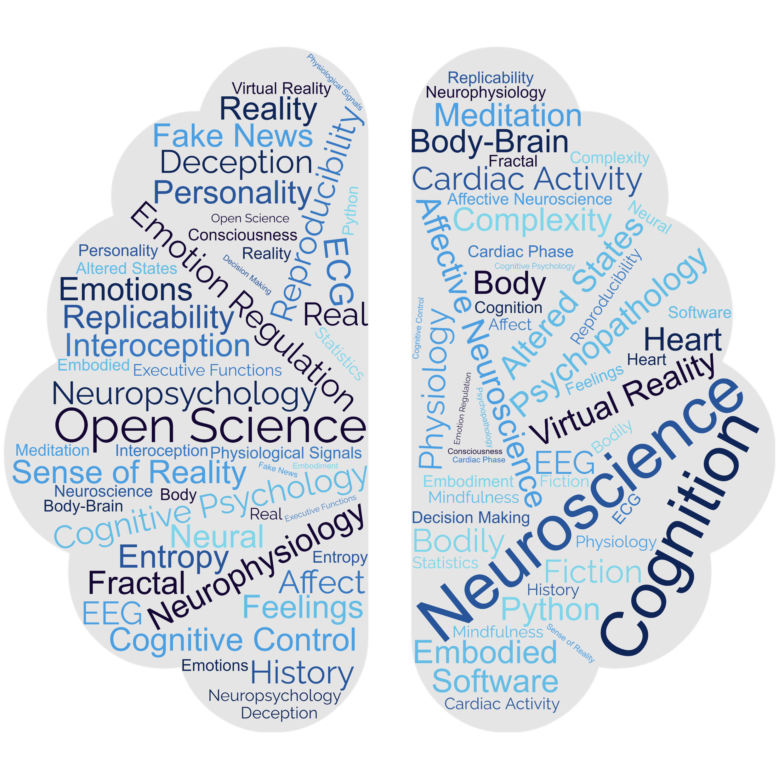
Dominique Makowski’s
Research Themes
Reality Bending
Core Self
Metascience
What are the mechanisms that drive and can alter our belief and feeling of reality?
How do cognitive abilities unfold into personality traits and metastable neuropsychological profiles?
What is the history of psychology and psychiatry? What are the methods and tools of tomorrow?

Slide 5
Metascience
and Methods
Experience of Reality
Conscious and Unconscious Feelings and Beliefs about Reality
easystats
Neuropsychological Assessment
IllusionGame
PrimalsInteroception
Pyllusion
FictionEro
FakeNews
NeuroKit
Bodily Signals
Affective reactions, Interoception, Embodiment
Cognitive Control
Executive functions
Who are we?
Sense of Self, Personality, Neuropsychological Profile, …
Interoception Assessment
Emotion Regulation Task
DoggoNogo
Willpower
Voluntary control of oneself

Slide 6

Experience of Reality
Conscious and Unconscious Feelings and Beliefs about Reality
PrimalsInteroception
IllusionGame
FictionEro
Pyllusion
FakeNews
Metascience
Methods
Improving science
Developping tools
Context
History
Philosophy of science
Avengers
Neuropsychological Profile
Who are we?
Sense of Self
Core Personality
…
How to measure it?
Psychometry
Clinical applications
…
NeuroKit
Bodily Signals
Affective reactions,
Interoception, Embodiment
Cognitive Control
Executive functions
Interoception Assessment
Emotion Regulation Task
DoggoNogo
Methods
Computational modelling
Bayesian framework
Signal processing
Chaos theory
Neuroimaging
….
Willpower
Voluntary control of oneself

